Slide 1
JBoss Rules Training
  Knowledge from the source
Notes:
Just an overview of what this module contains. The labs will be fairly “hands on” and will require plenty of time, depending on how must experimenting the students want to do above the exercises.
DSL == Domain Specific Language (in our case, this is as relates to writing production rules – note that DSLs are normally broader then rules, but in this case, it is really just referring to a technique of creating rule languages).

Slide 2
Introductions
  Who is everybody?
    Background
    Previous experience (Rules: ILog, Jess, Clips etc)
    Have you looked over JBoss Rules webinars/documentation?
    Any interesting projects you're working on?
    What are you expecting out of the course?
Notes:
Important to note past experience to measure how much background and basics will be needed.
Also, based on what their project needs are, can spend more time focusing on certain modules containing certain labs that are of interest. But keep in mind, they should have a wide view of the “correct” way to right declarative rules, rather then diving in too early.

Slide 3
Course agenda
  Day 1
    Intro & Overview of rule engine technolgies
    Introduction to JBoss Rules features
    Rule Engine concepts part 1 (core concepts)
    Rule Engine concepts part 2 (RETE algorithm)
  Day 2
    Applying JBoss Rules
    Other rule formats (rule capture)
    Dynamic rules and deployment
  Day 3
    Execution control
    Truth maintenance and advanced issues
    Building a BRMS (rule management system) and wrapping up
      Maybe some spare time to cover interest issues

Slide 4
What is a rule engine going to do for me
  Externalize business logic
    Logic that is complex
    Logic that changes often
    Logic that just doesn't fit neatly in code
    Logic that means more to domain experts then to programmers
  Keep application and user interface logic in your application
    Business logic in the rule engine
  Use domain objects as interface to rule engine
Notes:
People have used rule engines for things like validating data capture when there are complex frequently changing rules.
By externalise, we mean that the business logic is seperated from the application code, into rules.
Business logic may change more frequently then the application, and rules allow the business logic to change without redeploying the application with each change (and thus confronting the Preventer's of Information Technology department).
Rule engines are most often integrated “in process” but deploying them as reusable web services has become popular in an SOA world. The idea in the SOA world is that business rules are available as a reusable asset – so there is a single point of truth that any application on any platform can access remotely (for example rules on overtime payments). Rules can then be controlled (versioned, access control, auditing) for business policy in one place.

Slide 5
What is a rule engine
A rule engine at its core is a “shell” for capturing knowledge
  An applying that knowledge to specific data (facts)
  Uses “production rules”
    IF <conditions> THEN <actions>
    rules express logic (any logic can be expresses this way)
Has roots in AI research
    Successes of Expert Systems in the past triggered popularity of rule engines
Notes:
Artificial Intelligence (A.I.) is a very broad research area that focuses on "Making computers think like people" and includes disciplines like Neural Networks, Genetic Algorithms, Decision Trees, Frame Systems and Expert Systems. Knowledge representation is the area of A.I. concerned with how knowledge is represented and manipulated.
Expert Systems use Knowledge representation to facilitate the codification of knowledge into a knowledge base which can be used for reasoning - i.e. we can process data with this knowledge base to infer conclusions. Expert Systems are also known as Knowledge-based Systems and Knowledge-based Expert System and are considered 'applied artificial intelligence'; the process of developing with an Expert System is Knowledge Engineering. EMYCIN was one of the first "shells" for an Expert System, which was created from the MYCIN medical diagnosis Expert System. Where early Expert Systems had their logic hard coded "shells" separated the logic from the system, providing an easy to use environment for user input.
Drools is a Rule Engine that uses the Rule Based approached to implement an Expert System and is more correctly classified as a Production Rules System.
Business Rule Management Systems build value on top of a core Rule Engine providing systems for rule management, deployment, collaboration, analysis and end user tools for business users. Further to this the "Business Rules Approach" is a fast evolving and popular methodology helping to formalise the role of Rule Engines in the enterprise.
Production rules systems can express any logic at all, and the a rule engine like Drools can be described as “turing complete” meaning you can do anything in it (not necessarily the best tool though !)

Slide 6
Expert Systems and Rule engines
What is an expert system?
  Can provide expertise in a very narrow domain, like a human expert would
  Rule engine + specific rules (knowledge) = expert system
  A bit of an “old fashioned” term
  These days, Uis are typically web apps, e-business apps, voice etc.
  JESS, CLIPS are famous expert system shells
BRMS
  Means Business Rule Management System
  Higher level business rules (not as technical as expert systems)
Notes:
This aside on expert systems is provided in case people have heard the term mentioned (most people have) to clarify the relationship with rule engines, and their history. Modern rule engines have roots in successful expert systems.
Business rule systems build on these successes

Slide 7
What is inferencing?
We have lots of data (facts)
We have lots of knowledge (rules)
Lets make some conclusions !
Notes:
Inferencing is a term that will be heard often enough to need a brief explaination.
It is also important to note that in a rule engine, both data (fact) and knowledge (rules) change over time. Typically, facts change much more frequently then rules do.
A true inferencing engine can cope with both facts and rules changing (sometimes at the same time) in a stateful manner. Facts may be kept in memory, and a new rule is enforced for instance – all without having to re-enter the data again (the engine will know what data and rules have changed and do the minimum work to apply them).

Slide 8
What is a rule?
when
<conditions>
then
<actions>
A rule is made of conditions, and actions. When all the conditions are met, a rule may “fire”.
The conditions are collectively referred to as the LHS (left hand side) and the actions are refered to as the RHS (right hand side, or consequence).
A rule operates on facts (data) which in our case, are instances of objects from your application.
Notes:
Note that we say “may” fire, as there is the concept of an “agenda” to be discussed later which slightly complicates this. But in essence, it is that simple.
The LHS effectively acts a bit like SQL – querying for combinations facts that match the criteria on the LHS. For each match (sometimes called a “tuple” of facts), a rules actions may be fired for that combination of facts.

Slide 9
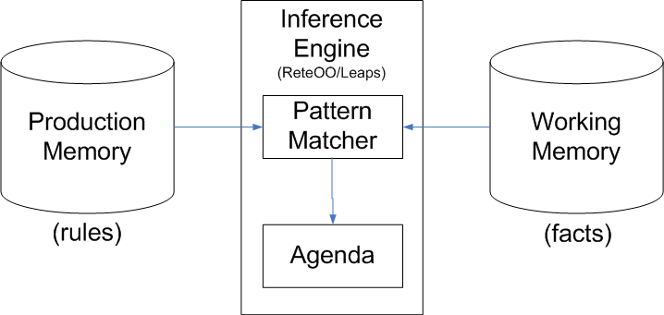
The brain
The brain of a Production Rule System is an
Inference Engine which matches facts against Production Rules.
When matches are found, the rules actions are fired
Actions are most often changing the state of the facts, or
performing some “external” action on the application.
Notes:
Agenda is the place where rules are “queued” up ready to have their actions fired.

Slide 10
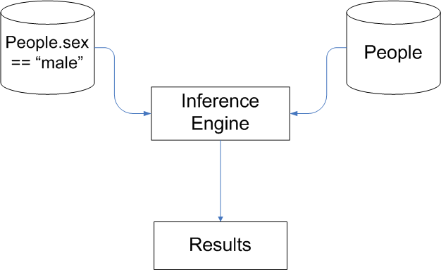
Inference example
This looks for and matches all males in a data-set (facts) of “People”
Jess: (person (sex male))
Drools: Person(sex==”male”)
SQL: select * from People where sex = 'male'
Notes:
This is to clarify the previous slides diagram.
Most of the work happens in satisfying the LHS. Think like an SQL database engine, and you will be close (a lot of the same techniques around indexing are often applied).
When a rules actions are fired, it may change the facts, but it may just do something like “send an email” or return a result back to the application that called it.

Slide 11
Other types of rule engines (which we will not talk about)
Scripting engines
  They allow lots of flexibility (changes on the fly)
  But are tightly coupled to the calling code
  Easier (sometimes) to use, but less flexible long term
  Don't solve hard problems
  Just an alternative to code when the host language (Java) is not flexible enough.
Process engines
  Eg jBPM
  Allow definition of parallel processes
  Simple decision rules
Anything that allows changes on the fly
Notes:
Mention that many products claim to be rule engines, but may be really just scripting engines, or another way of managing code. Even database lookup tables sometimes get termed as rule engines.
In our opinion, the power of rule engines is in how they inference facts with data, rather then be another way to write code.
These other types of systems certainly have their uses, but be aware of claims they they are full blown rule engines. Lots of engineering goes into engines like Jboss Rules, Jess, Jrules etc to make things work smoother for you in the end.
On the other hand, a full blown RETE engine can be overkill in some cases, when a database lookup plus a limited scripting language would be a better fit (RETE often sacrifices memory for speed with large numbers of facts and rules and time – if you aren't worried about that, RETE can be overkill initially).

Slide 12
Making applications think
Concepts from AI can be used in your applications, through rule engines
For example: a rule “firing” is similar to neuro-science concept of a neuron firing, then “refracting” until there is more stimulus (facts change, rules change)
Another example: The Reticular Activation System: Ever bought a new car, and suddenly you notice lots of the same cars on the road? Rule engines can emulate this with “control facts”.
Rule engines can often explain their actions – the chain of “firings” and what cause them.
Other AI concepts: artificial neural networks, genetic algorithms (not related to rule engines). But expert systems have been highly successful so far.

Slide 13
Rule engines – to recap
The difference between expert systems and rule engines
  Rule engines are the “empty shell”
  Rule engines allow capture of
    knowledge (rules – change sometimes)
    data (facts – change often)
    combine the two (inference) to reach conclusions, take actions
Expert systems really started it all off
  In the 1970s
  MYCIN, EMYCIN
Production rules
  Have become effective means of capturing knowledge

Slide 14
Business rules
Expert systems typically focused on hard, technical problems
Business rules are often “softer” problems
  Many many simple rules, that add up to a mess to implement in traditional code

Slide 15
Natural language
As business rules represent business concepts, natural language expressions may be used to express the rule conditions and actions.
This allows non technical folk to validate and understand the business logic that is driving their business.
Other forms of expression (such as graphical – process flows, decision tables) can also achieve this, sometimes better then natural language.

Slide 16
Controversy
Business users changing rules
  Has been referred to as “executives creating spaghetti code”
  Has been oversold/overhyped
  Disaster stories
    Often people need to replace system with a hard coded simple app
  The “no code, no developers” fallacy
  Don't believe the hype
What is realistic
  Business users understanding logic, suggesting changes
  In controlled Uis, making changes to rule parameters
    Decision tables excellent construct for this
    Web Uis excellent
Notes:
Lies, damned lies and sales whitepapers.
As with all hype, there is a kernel of truth. Business users should be able to validate the business logic. With natural language expression this is more definitely possible. They may even be able to make changes in a controlled way (as long as it is validated).
Decision tables have worked well in this regard in the past.
In future versions, web based management Uis will assist with this workflow, allowing rules to be edited/created based on templates that control what can be edited, by whom, and what process the change goes through before it it put into production.
The “no code” solutions out there are often met with disaster – there is no such thing as “no code” - perhaps they mean no textual code? Who knows...
Solutions that allow people to model data, and rules, and play and get instant feedback will come in the future.

Slide 17
The problem with normal people
Normal people aren't logical
Programmers are (sometimes)
“You can have Ice Cream or Pie for dessert”
  Dessert(type == “ice cream”) || Dessert(type == “pie”)
“Ok, I will have both”
“what???”
OR is not XOR, yet 99% of the population thinks it is.
  If this is the case with basic logic, how can we expect most people to write logically correct rules un-assisted, if there are small mis-understandings like this.
Notes:
This ties in to the previous slide.
The point of this is that rules are not to replace programmers, but to free them up. Regular people will never really get logic. So to make “business” rules managable by non technical people, we need to have really really tightly controlled tools. Its not impossible, just don't believe the hype.

Slide 18
Declarative programming
Well written rules are “declarative”
  Declarative means saying “what” not “how”
  SQL is the most mainstream example
Languages like Java, C#, C, Python, Ruby etc are imperative
Rules are at odds with Object Oriented programming
  OO is about encapsulation
  Rules break encapsulation

Slide 19
Language families
<diagram here>

Slide 20
Other products out there
  Jess, Clips (expert system shells)
  ILog Jrules, Blaze Advisor, Hayley (BRMS)

